Slide 1
Updates 6-28-20
Akash Levy

Slide 2
Overview
High-T retention training
High-T retention formula
Conductance range spread histograms
Inner and outer range methodology
Plans

Slide 3

High-T Retention Formula
Firstly, extracted $E_{a}$ from IEDM retention figure using slope
Looked at green curve which has lowest slope ($E_{a})$
Conservative estimate!
Need two points: $\left(t_{f}, T\right)$
Point 1: $\left(10 yrs, 123℃\right)=(3.15{×10}^{8} s, 396 K)$
Point 2: $\left(1000 s, 490 K\right)$

Slide 4
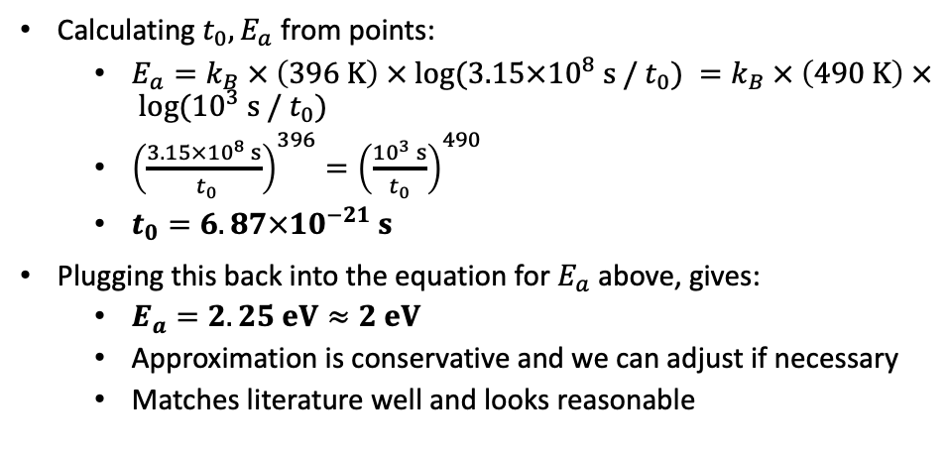
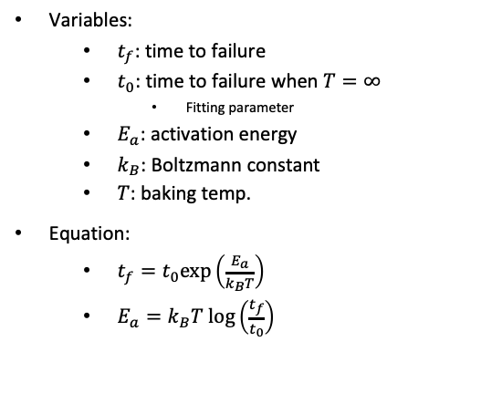
High-T Retention Formula
Variables:
$t_{f}$: time to failure
$t_{0}$: time to failure when $T=∞$
Fitting parameter
$E_{a}$: activation energy
$k_{B}$: Boltzmann constant
$T$: baking temp.
Equation:
$t_{f}=t_{0}exp\left(\frac{E_{a}}{k_{B}T}\right)$
$E_{a}=k_{B}T log\left(\frac{t_{f}}{t_{0}}\right)$
Calculating $t_{0}, E_{a}$ from points:
$E_{a}=k_{B} × \left(396 K\right) × log⁡(3.15×{10}^{8} s /{ t}_{0}) =k_{B} × \left(490 K\right) × log⁡({10}^{3} s /{ t}_{0})$
${\left(\frac{3.15×{10}^{8} s}{{ t}_{0}}\right)}^{396}={\left(\frac{{10}^{3} s}{t_{0}}\right)}^{490}$
$t_{0}=6.87×{10}^{−21} s$
Plugging this back into the equation for $E_{a}$ above, gives:
$E_{a}=2.25 eV≈2 eV$
Approximation is conservative and we can adjust if necessary
Matches literature well and looks reasonable

Slide 5

High-T Retention Formula
If we want 10-year retention at RT, $T=298 K$, $t_{f}=3.15×{10}^{8} s$:
$t_{0}=3.15×{10}^{8} s ×\exp\left(−\frac{E_{a}}{k_{B} × 298 K}\right)=4.724×{10}^{−26} s$
We want to bake for 30 minutes, so we solve for temperature:
$T=\frac{E_{a}}{k_{B}\log\left(\frac{t_{f}}{t_{0}}\right)}=\frac{2 eV}{k_{B} ×\log\left(\frac{30×60 s}{9.618×{10}^{−28} s}\right)} =352.67 K≈80℃$
If we want 3-month retention at $70℃$, T = 343 K, t = 7.88e6 s:
$t_{0}=7.88×{10}^{6} s ×\exp\left(−\frac{E_{a}}{k_{B} × 343 K}\right)=3.236×{10}^{−23} s$
We want to bake for 30 minutes, so we solve for temperature:
$T=\frac{E_{a}}{k_{B}\log\left(\frac{t_{f}}{t_{0}}\right)}=\frac{2 eV}{k_{B} ×\log\left(\frac{30×60 s}{3.236×{10}^{−23} s}\right)} =391.51 K≈120℃$

Slide 6
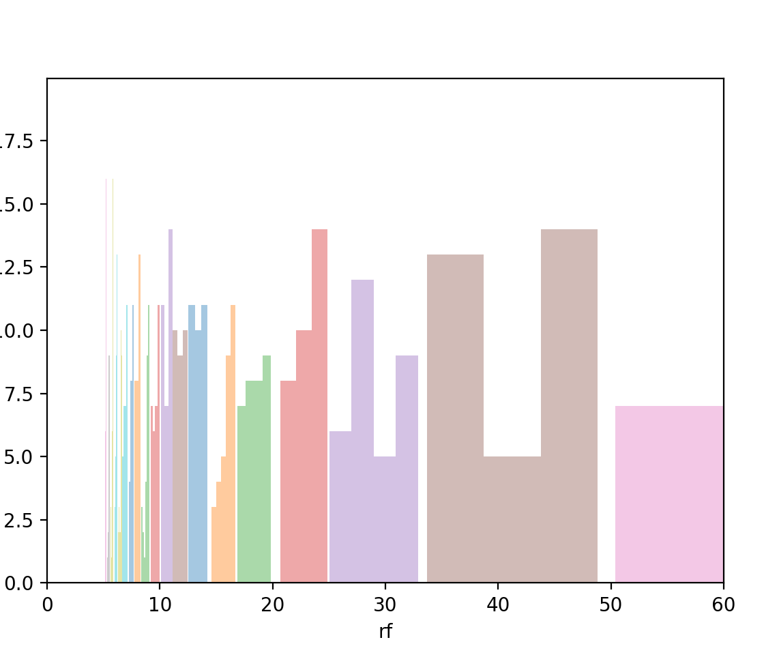
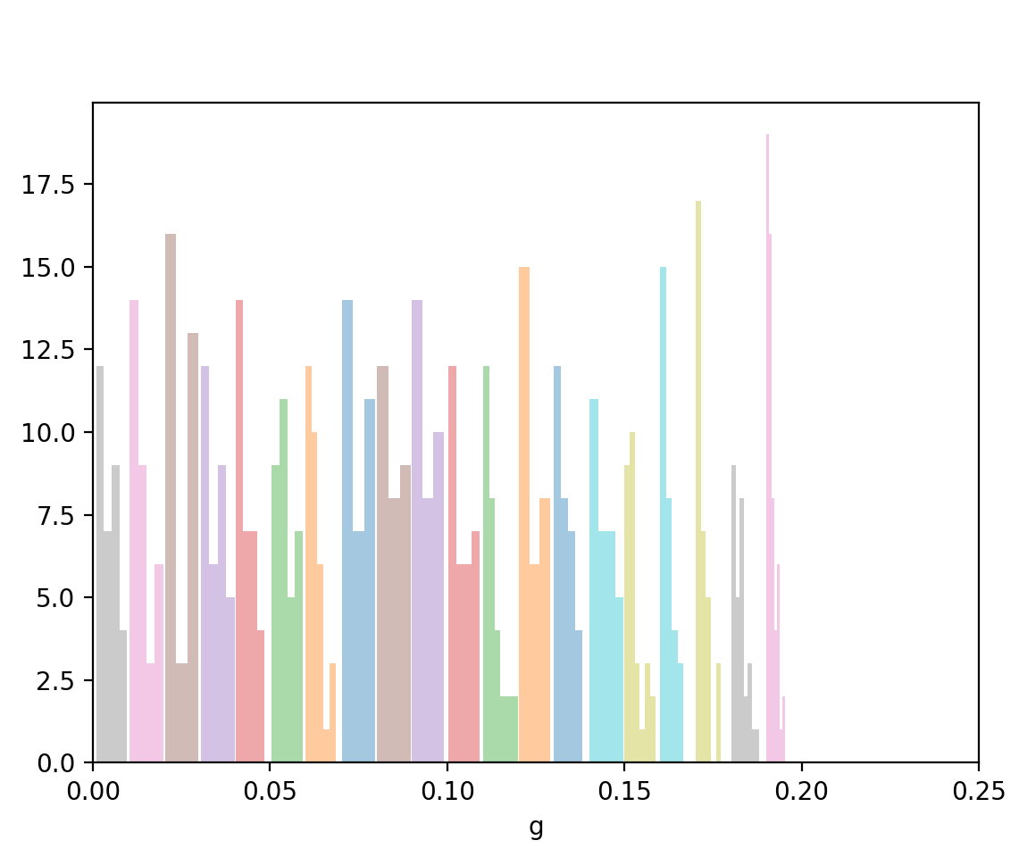
Conductance Range

Slide 7
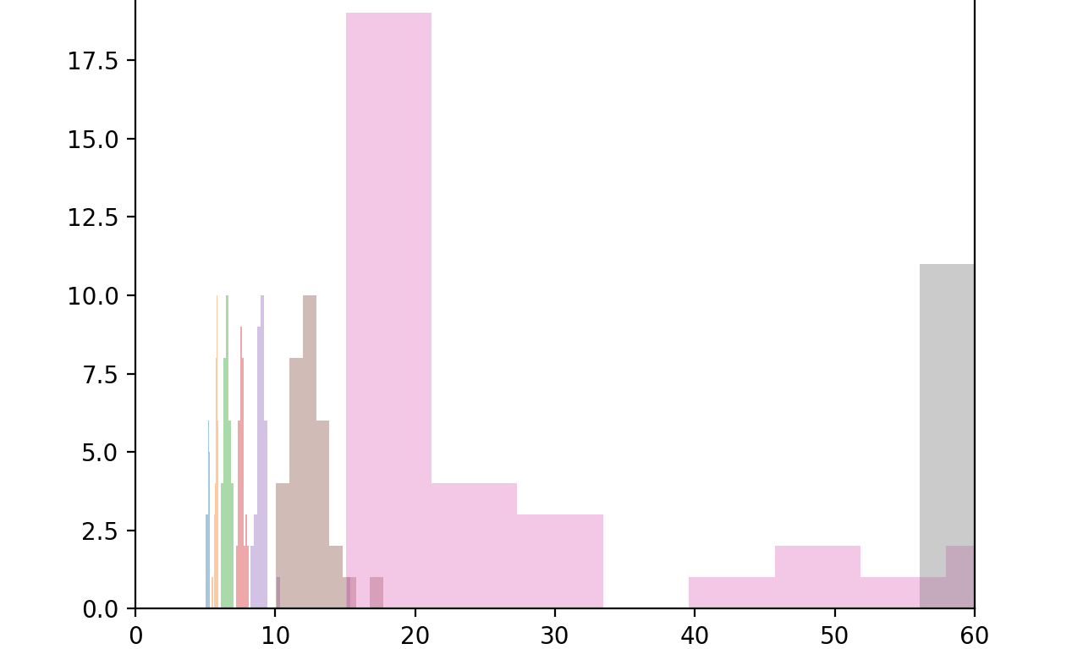
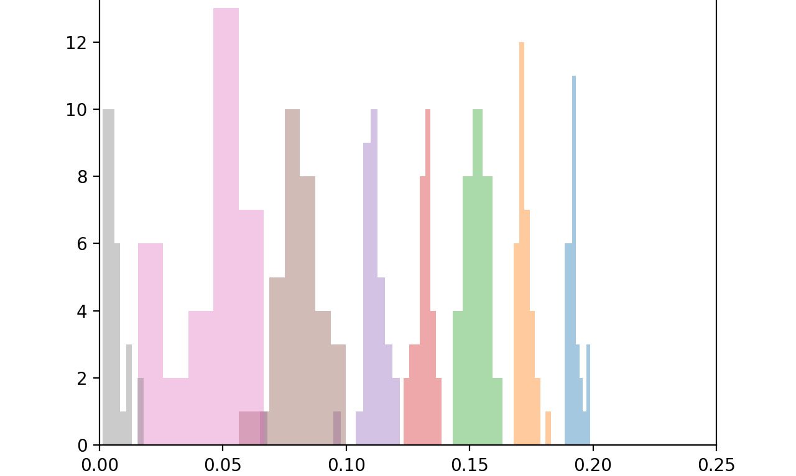
Conductance Range

Slide 8
Conductance Ranges
 | Gmin | Gmax | Rmax | Rmin | Gap
Level 7 | 0 | 0.00001 | 1E+10 | 100000 | 80000
 | 0.00001 | 0.00002 | 100000 | 50000
 | 0.00002 | 0.00003 | 50000 | 33333.3333333333
 | 0.00003 | 0.00004 | 33333.3333333333 | 25000
 | 0.00004 | 0.00005 | 25000 | 20000
Level 6 | 0.00005 | 0.00006 | 20000 | 16666.6666666667 | 30000
 | 0.00006 | 0.00007 | 16666.6666666667 | 14285.7142857143
 | 0.00007 | 0.00008 | 14285.7142857143 | 12500
Level 5 | 0.00008 | 0.00009 | 12500 | 11111.1111111111 | 4166.6666666667
 | 0.00009 | 0.0001 | 11111.1111111111 | 10000
 | 0.0001 | 0.00011 | 10000 | 9090.90909090909
Level 4 | 0.00011 | 0.00012 | 9090.90909090909 | 8333.33333333333 | 641.02564102564
 | 0.00012 | 0.00013 | 8333.33333333333 | 7692.30769230769
Level 3 | 0.00013 | 0.00014 | 7692.30769230769 | 7142.85714285714 | 476.19047619047
 | 0.00014 | 0.00015 | 7142.85714285714 | 6666.66666666667
Level 2 | 0.00015 | 0.00016 | 6666.66666666667 | 6250 | 367.64705882353
 | 0.00016 | 0.00017 | 6250 | 5882.35294117647
Level 1 | 0.00017 | 0.00018 | 5882.35294117647 | 5555.55555555556 | 292.39766081872
 | 0.00018 | 0.00019 | 5555.55555555556 | 5263.15789473684
Level 0 | 0.00019 | 0.0002 | 5263.15789473684 | 5000

Slide 9
Inner and Outer Range Methodology
Start with outer range: Rmin and Rmax
Want to get inner range (programming targets)
Method:
Convert Rmin and Rmax to conductance Gmax and Gmin
Do weighted average of conductance
0.2 * Gmax + 0.8 * Gmin
0.8 * Gmax + 0.2 * Gmin
Convert back to resistance

Slide 10
High-T Retention Training
Sent email to Eric Pop
Got trained by Xin today
Started baking a sample but got locked out

